Slide 1
Summarize News Articles with Machine Learning
Name: Manish Singh
Roll NO: 2101106(26)
Course: MCA B II

Slide 2
Introduction of the project:
This project “Summarize News Articles with Machine Learning” is a simple GUI application. It is generate summaries of news articles by extracting important sentences from a news.

Slide 3
Objective of Project:
The main objective of the Project is to Create a short, accurate, and fluent summary of a long text news article.

Slide 4
Functionalities provided by Summarize News Articles GUI Application :
Display the Title.
Display the Author Name.
Display Publication Date.
Display Summary.
Display Sentiment.

Slide 5
Scope of the project:
Text summarization application is useful in many ways to summarize the textual data. Some of the uses of text summarization are:
To reduce the reading time of long documents
While researching documents, summaries make the selection process easier.
The text summarizes are useful for question-answer systems.
Using a text summarization Application enables commercial abstract services to increase the number of text documents to process. Several news portals such as Google News, Inshorts, etc provide short summaries of the long news article for their readers.

Slide 6
Tool/Platform, Hardware and software Requirement specifications:
Software requirements:
Hardware Requirements:
Operating System | Windows 7, Windows 10, Ubuntu
Language | Python
IDE | Visual Studio Code
Processor | Intel core i3
RAM | 128 MB
Hard disk | 1 GB

Slide 7
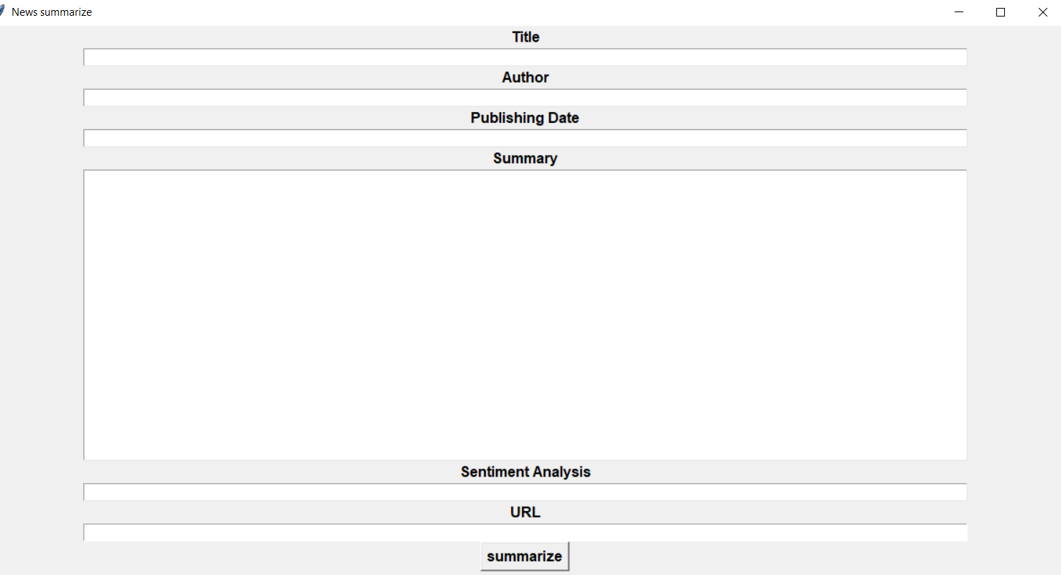
Project Output:

Slide 8
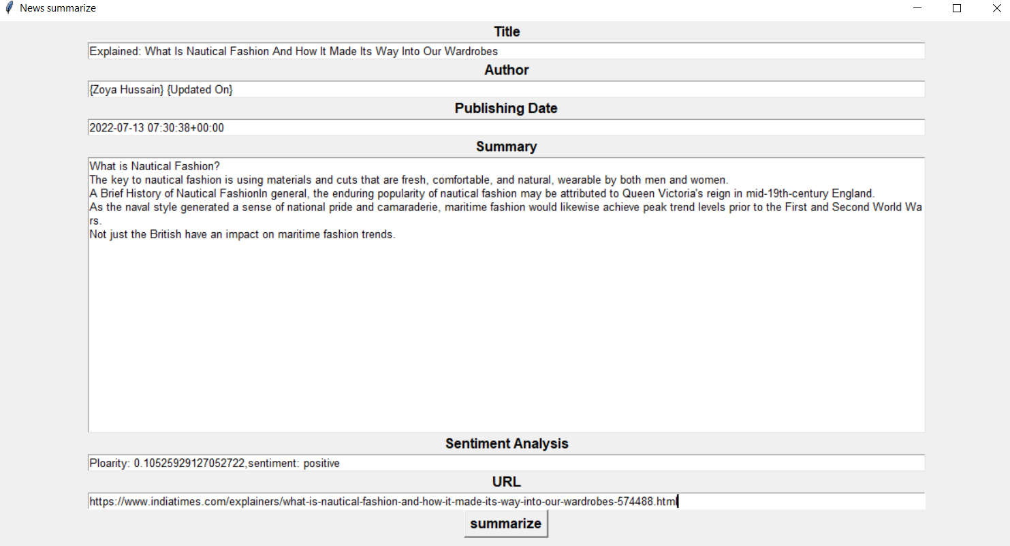

Slide 9
Thank you

